Slide 1


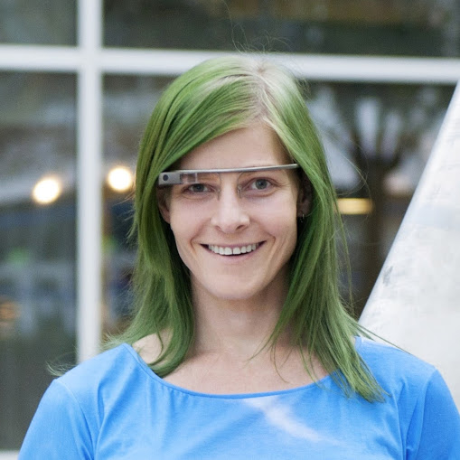
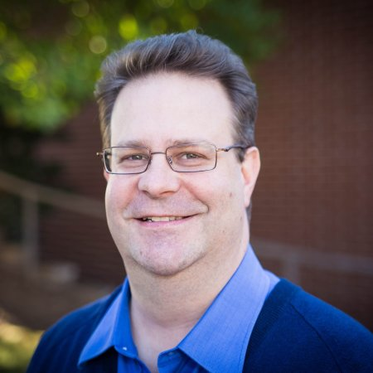
Wait! Wait! Don’t pwn me!
The Security News Game Show

Slide 2

#DontPwnMe
@TSWAlliance

Slide 3
The Rules
Each correct answer to the initial question is worth 3 points
A wrong answer subtracts 2 points
A pass on a question loses 1 point
A correct answer from an audience member gets allocated 2 points to the panelist of their choice

Slide 4
The Rules
The moderator may arbitrarily
give or take away points at any time

Slide 5
The Rules
We need a volunteer to keep score.

Slide 6
To get a copy of the slides
immediately…
mmiller@sonatype.com

Slide 7








Online News Resources

Slide 8


Slide 9

Researchers have found a way to take down the power grid through something in your home. What is it?

Slide 10
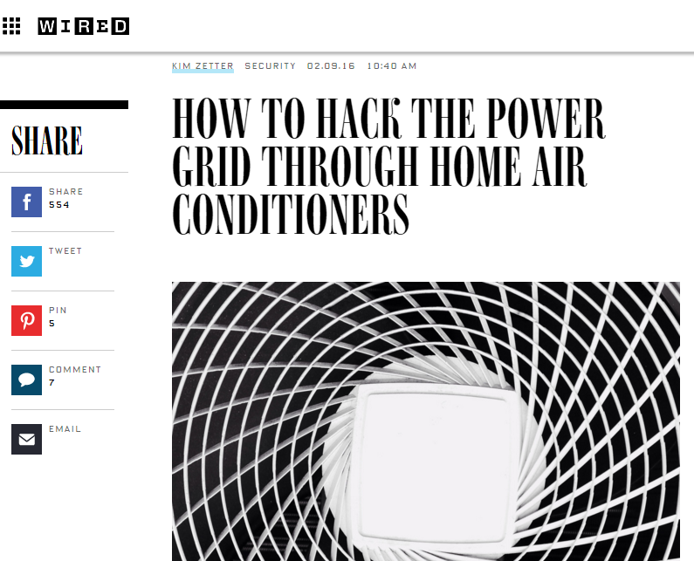
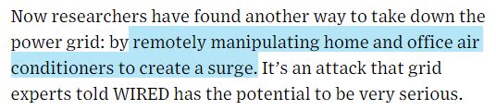
Notes:
http://www.wired.com/2016/02/how-to-hack-the-power-grid-through-home-air-conditioners/

Slide 11
On February 5, 2016, a UN Working Group on Arbitrary Retention declared a specific internet celebrity is being held illegally. Who is it?

Slide 12
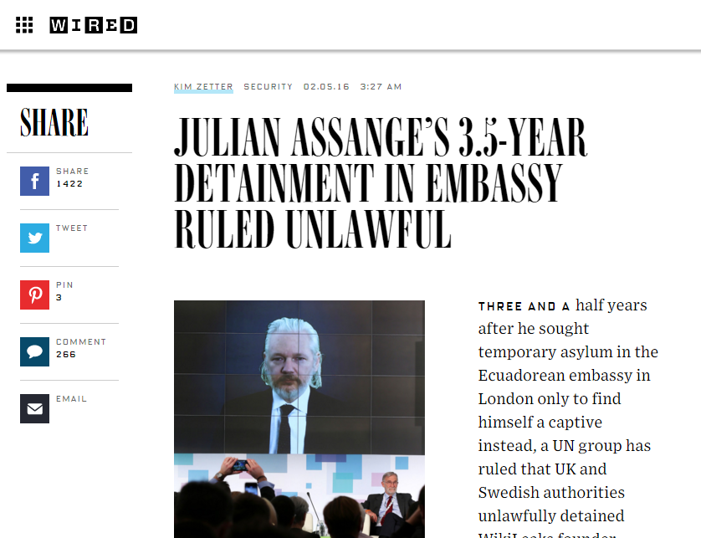
Notes:
http://www.wired.com/2016/02/julian-assanges-3-5-year-detainment-in-embassy-ruled-unlawful/

Slide 13
What should you do to keep the NSA Hacker Chief out of your system?

Slide 14
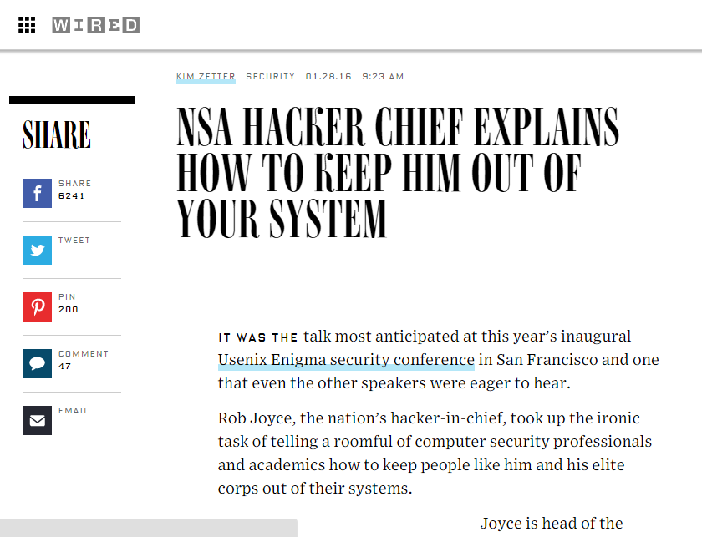
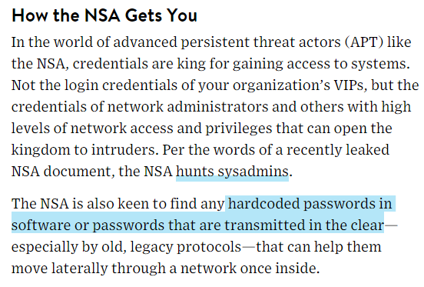
Notes:
http://www.wired.com/2016/01/nsa-hacker-chief-explains-how-to-keep-him-out-of-your-system/

Slide 15
At the Enigma Security Conference in San Francisco, Nicholas Weaver talked about a system that could do what?
(Hint: It competes on a miniature scale with a three letter agency.)

Slide 16
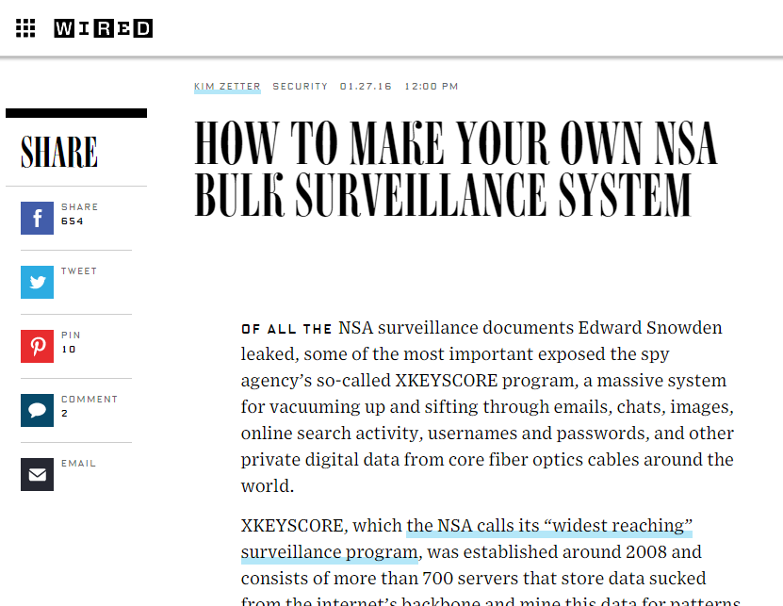
Notes:
http://www.wired.com/2016/01/how-to-make-your-own-nsa-bulk-surveillance-system/

Slide 17
Two power distribution companies in what country said hackers had hijacked their systems to cut power to more than 80,000 people.

Slide 18
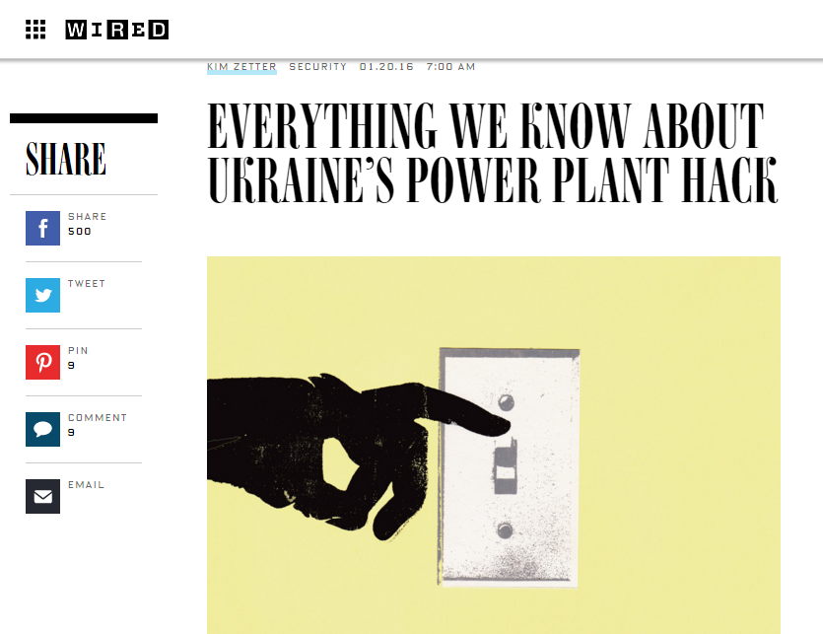
Notes:
http://www.wired.com/2016/01/everything-we-know-about-ukraines-power-plant-hack/

Slide 19
Name one of the top five biggest security threats of 2016 according to Wired.

Slide 20
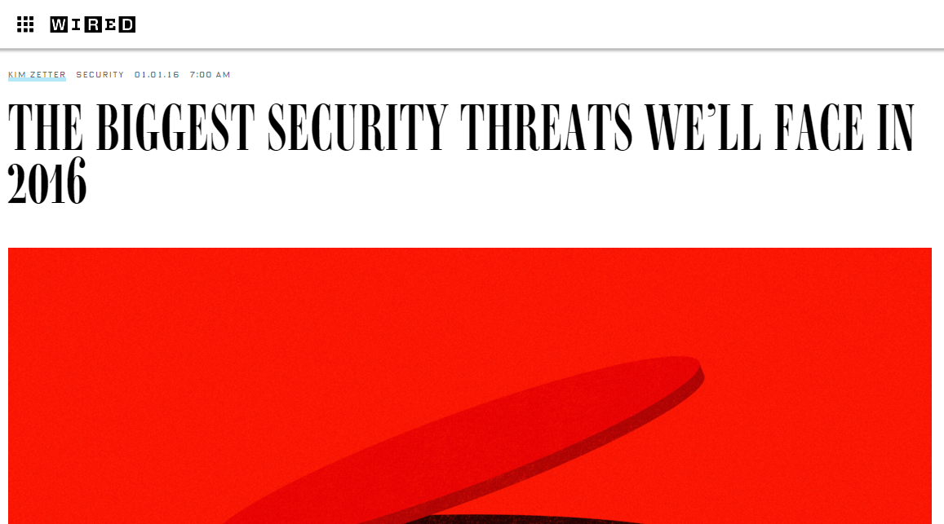
Extortion Hacks
Attacks that change or manipulate data
Chip-and-Pin Innovations
The Rise of the IoT Zombie Botnet
More Backdoors
Notes:
http://www.wired.com/2016/01/the-biggest-security-threats-well-face-in-2016/

Slide 21

Name one of the five comics you must read before seeing DeadPool.

Slide 22
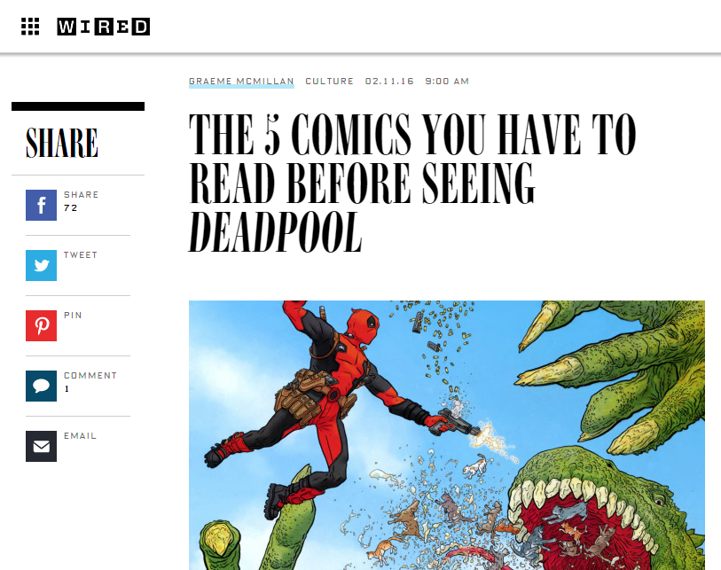
Deadpool Vol. 3 #1-33 (1997-1999)
Cable & Deadpool #1-6 (2004)
Deadpool Max #1-12 (2010-2011)
Uncanny X-Force Vol. 1 #25-35 (2011-2012)
Deadpool Vol. 5 #13-19 (2013)
Notes:
http://www.wired.com/2016/02/deadpool-reading-list/

Slide 23


Slide 24

Valentine’s Day saw major hacks against which, major merchant group?

Slide 25
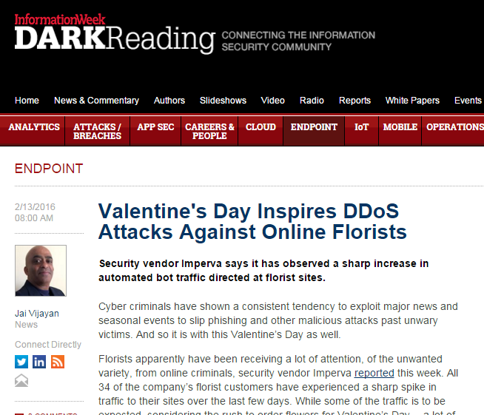
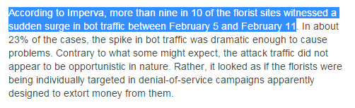
Notes:
http://www.darkreading.com/endpoint/valentines-day-inspires-ddos-attacks-against-online-florists-/d/d-id/1324312?

Slide 26
“Man Admits To Laundering $19.6 Million in Hacking, Telecom Fraud Scam”. What did he do?

Slide 27
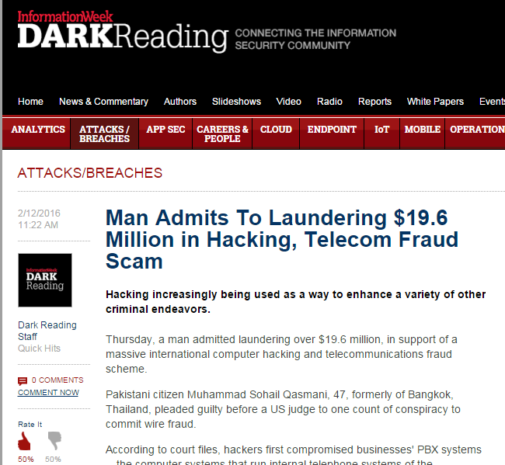
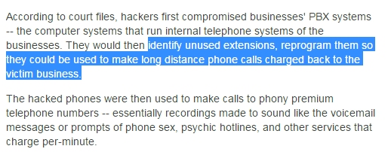
Notes:
http://www.darkreading.com/attacks-breaches/man-admits-to-laundering-$196-million-in-hacking-telecom-fraud-scam/d/d-id/1324296?ngAction=register#

Slide 28
What health care company had the largest breach of 2015, exposing the personal data of over 80,000,000 patients?

Slide 29
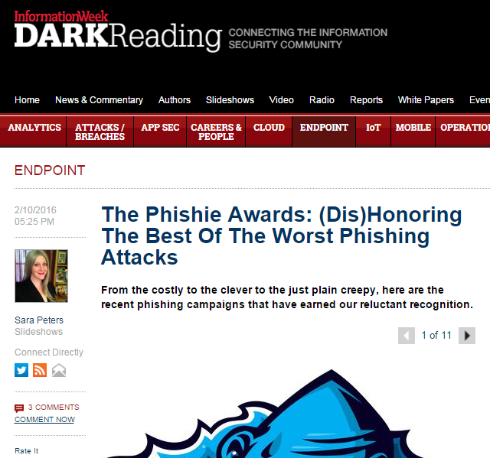
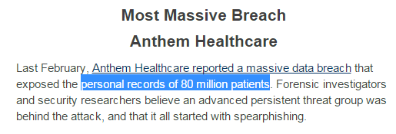
Notes:
http://www.darkreading.com/endpoint/the-phishie-awards-(dis)honoring-the-best-of-the-worst-phishing-attacks-/d/d-id/1324135?

Slide 30
According to James Clapper, US Director of National Intelligence, this is the next surveillance frontier.

Slide 31
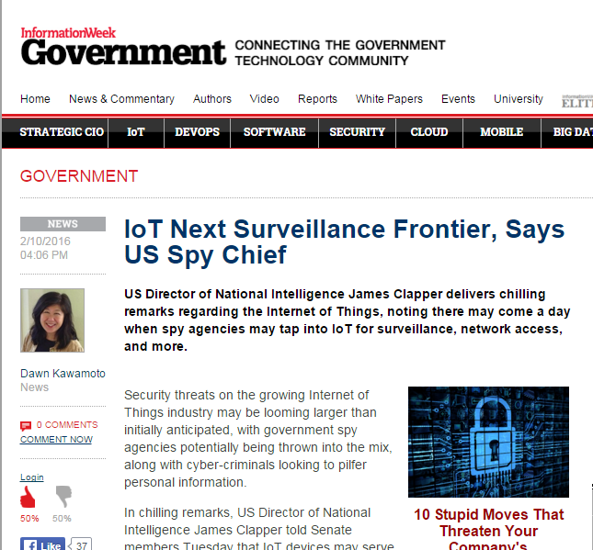
Notes:
http://www.informationweek.com/government/iot-next-surveillance-frontier-says-us-spy-chief/d/d-id/1324261

Slide 32


Slide 33

Which of the major movie stream providers got called out by Symantec for malware, scams and phishing schemes?
Amazon Prime Video
Netflix
Hulu

Slide 34
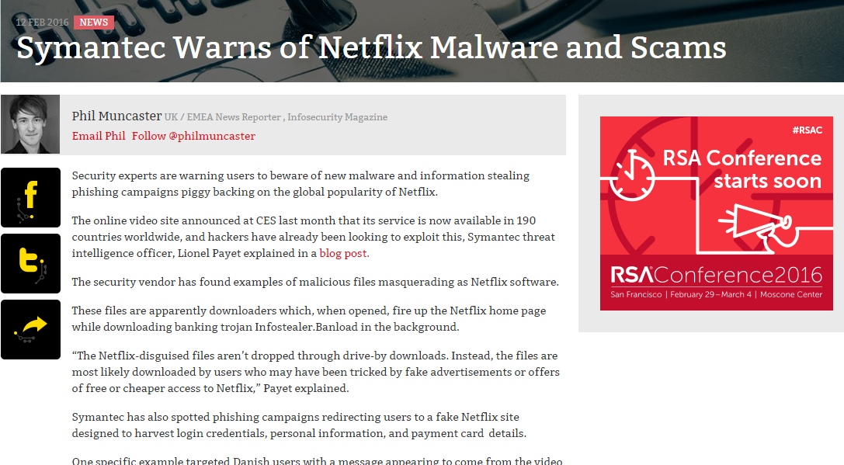
Notes:
http://www.infosecurity-magazine.com/news/symantec-warns-of-netflix-malware/

Slide 35
Which non-browser based application was hit with the latest malvertising scam?

Slide 36
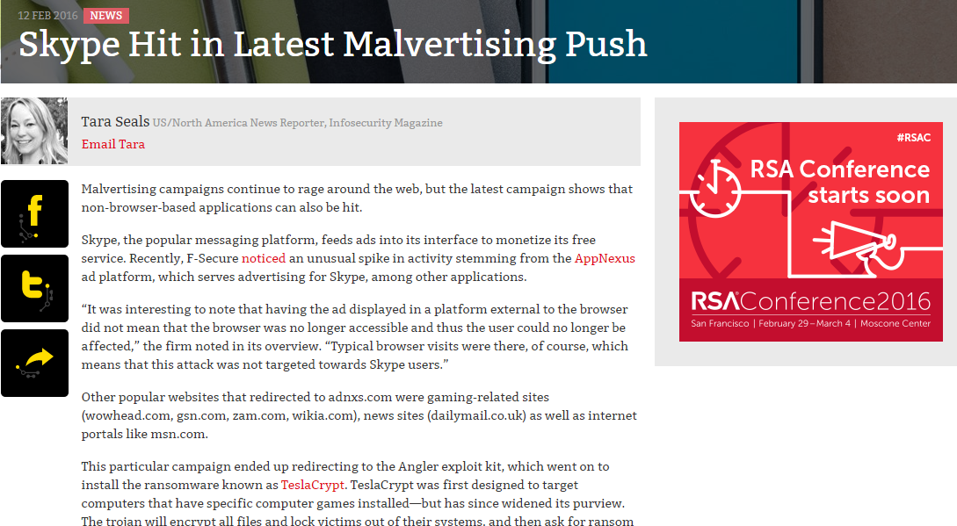
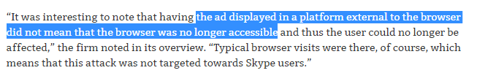
Notes:
http://www.infosecurity-magazine.com/news/skype-hit-in-latest-malvertising/

Slide 37
What percentage of mobile apps have at least one high security risk flaw?

Slide 38
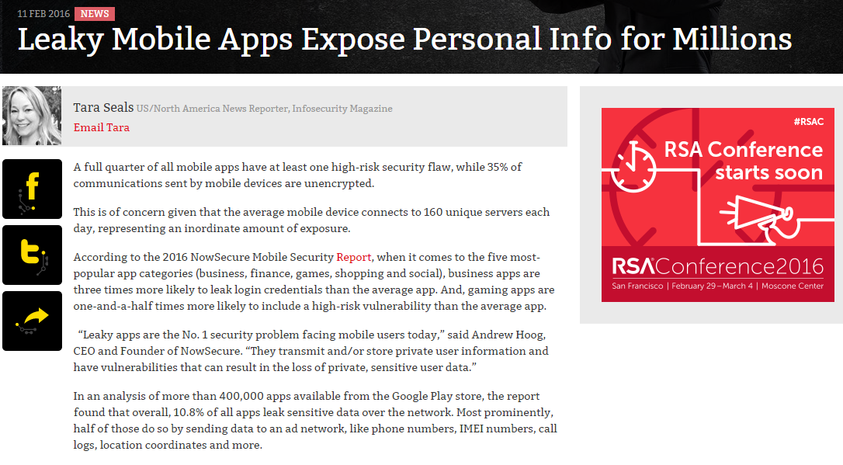
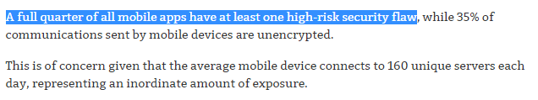
Notes:
http://www.infosecurity-magazine.com/news/leaky-mobile-apps-expose-personal/

Slide 39
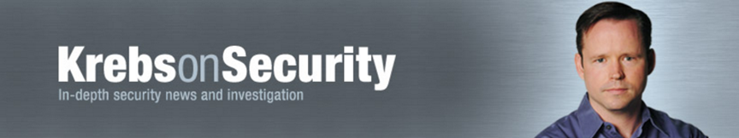

Slide 40

What percentage of ID theft can be attributed to tax refund fraud?
23%
34%
47%

Slide 41
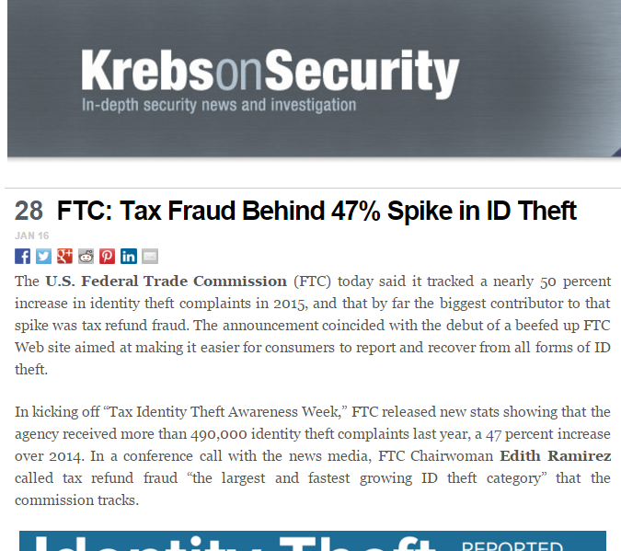
Notes:
http://krebsonsecurity.com/2016/01/ftc-tax-fraud-behind-47-spike-in-id-theft/

Slide 42

Oracle confirmed it’s next major release of Java will no longer do what?
Completely hose your browser during an important live meeting
Plug directly into your browser
Be compatible with Windows 7 or less
Call home to Oracle with no notice

Slide 43
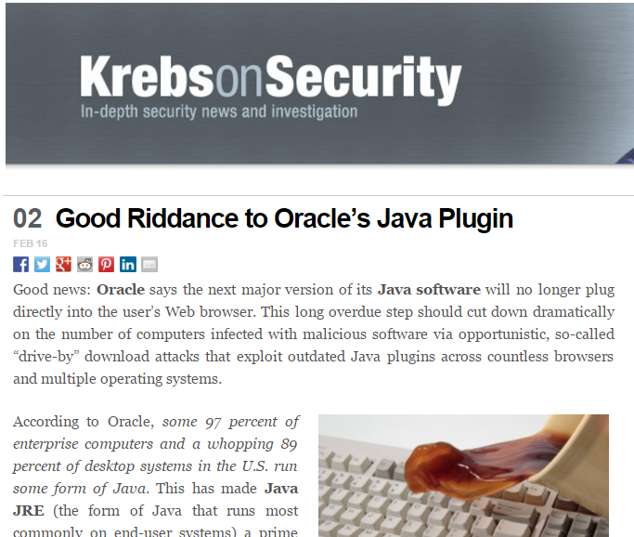
Notes:
http://krebsonsecurity.com/2016/02/good-riddance-to-oracles-java-plugin/

Slide 44
What major grocery chain got hacked with skimmers at the self-service checkout kiosks?
Safeway
Piggly Wiggly
Albersons

Slide 45
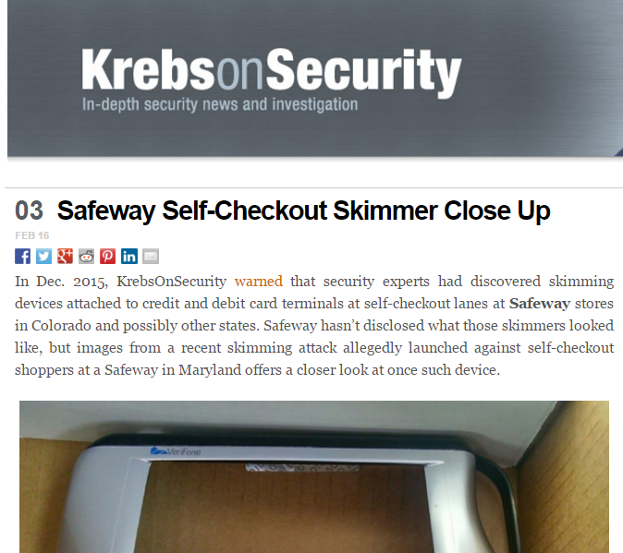
Notes:
http://krebsonsecurity.com/2016/02/safeway-self-checkout-skimmer-close-up/

Slide 46
ComfortLink thermostats come with a “interesting” hole in their security. What is it?
Hardcoded passwords
Cross-frequency interference to your local wireless network
All devices have the same default password

Slide 47
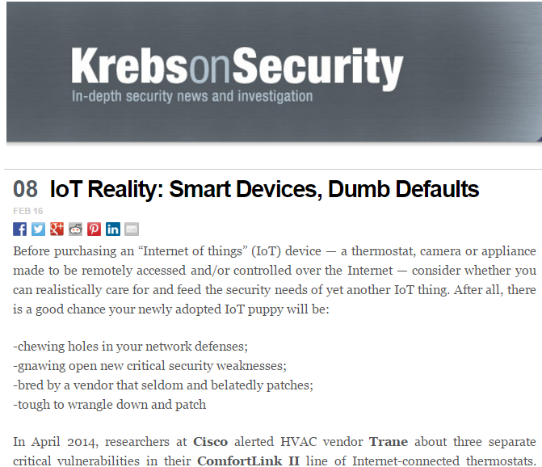
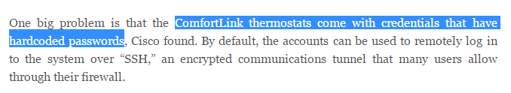
Notes:
http://krebsonsecurity.com/2016/02/iot-reality-smart-devices-dumb-defaults/

Slide 48
How are fraudsters tapping Kohl’s for cash through the “Kohl’s Cash” program?

Slide 49
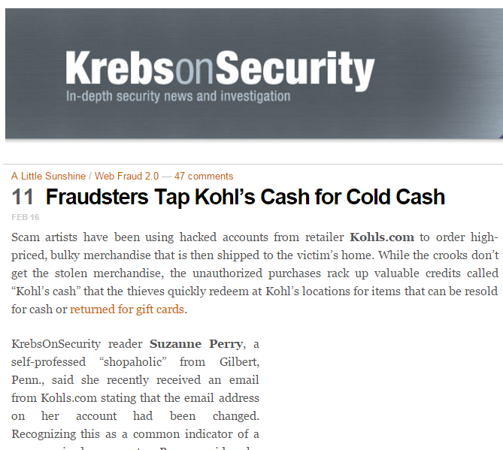
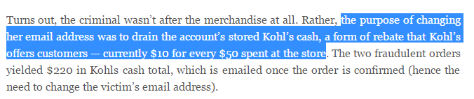
Notes:
http://krebsonsecurity.com/2016/02/fraudsters-tap-kohls-cash-for-cold-cash/

Slide 51
Women are considered better coders… if they do this one, specific thing.

Slide 52
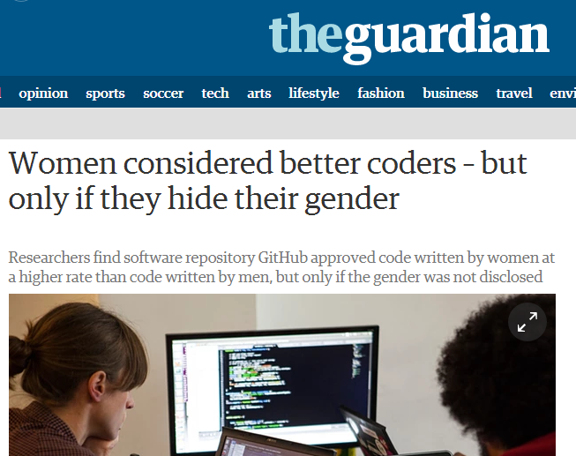
Notes:
http://www.theguardian.com/technology/2016/feb/12/women-considered-better-coders-hide-gender-github

Slide 53
What’s the most nonsensical way to brick your iPhone, iPad or iPad touch?
Pinch photos so small, machine crashes and won’t reboot
Set the date to 1 January 1970
Connect to an unknown service to download a “patch”

Slide 54
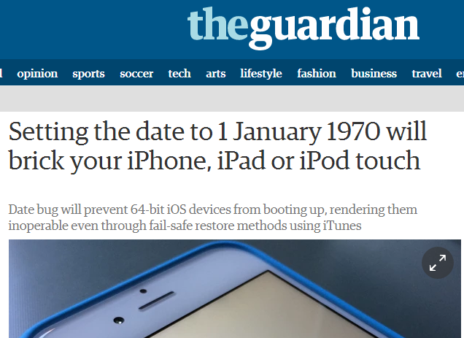
Notes:
http://www.theguardian.com/technology/2016/feb/12/setting-the-date-to-1-january-1970-will-brick-your-iphone-ipad-or-ipod-touch

Slide 55
“Error 53” on an iPhone 6 has a lot of people pissed off. What does it do?

Slide 56
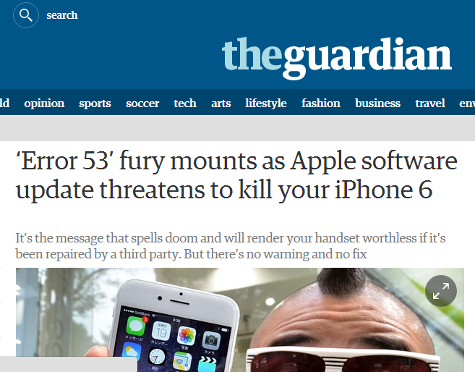
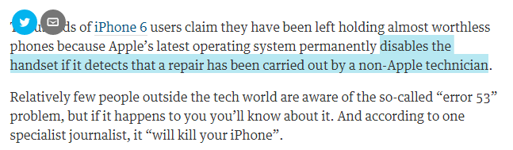
Notes:
http://www.theguardian.com/money/2016/feb/05/error-53-apple-iphone-software-update-handset-worthless-third-party-repair

Slide 58
After the announcement of WebSense being acquired by Ratheon, what did scammers send as email to WebSense employees?

Slide 59
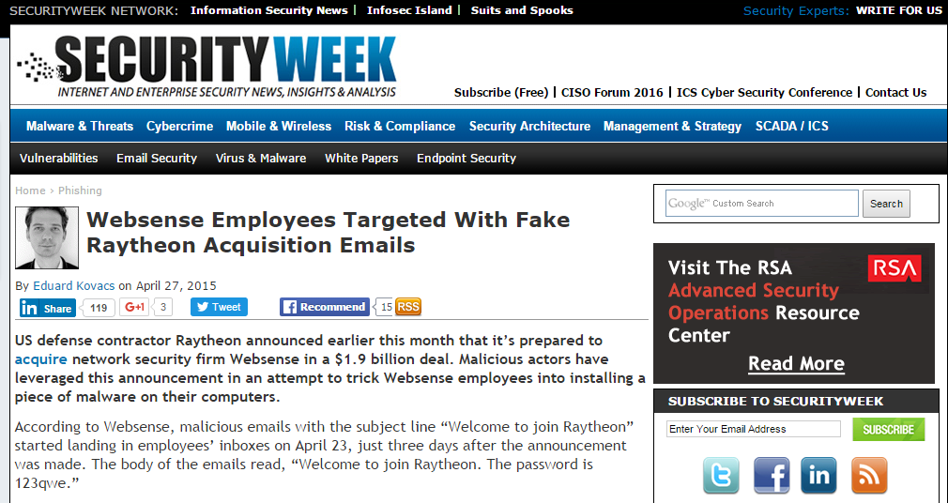
Notes:
http://www.securityweek.com/websense-employees-targeted-fake-raytheon-acquisition-emails

Slide 60
PhishMe just raised $13 million in funding. What do they do?

Slide 61
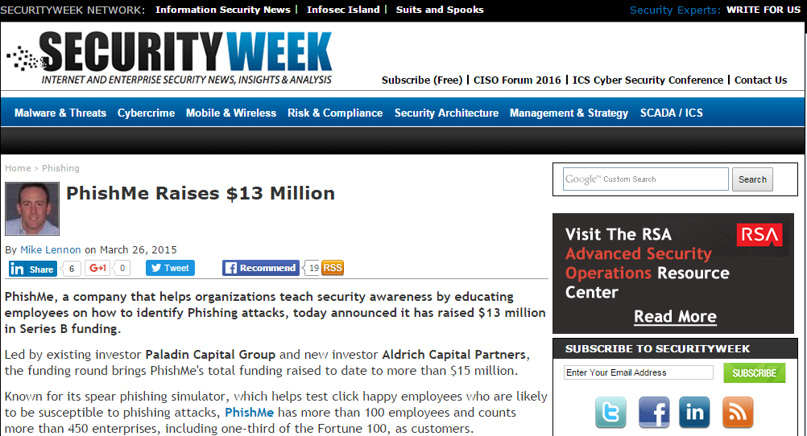
Notes:
http://www.securityweek.com/phishme-raises-13-million

Slide 62
Name one of the top three phishing trends for 2016.

Slide 63
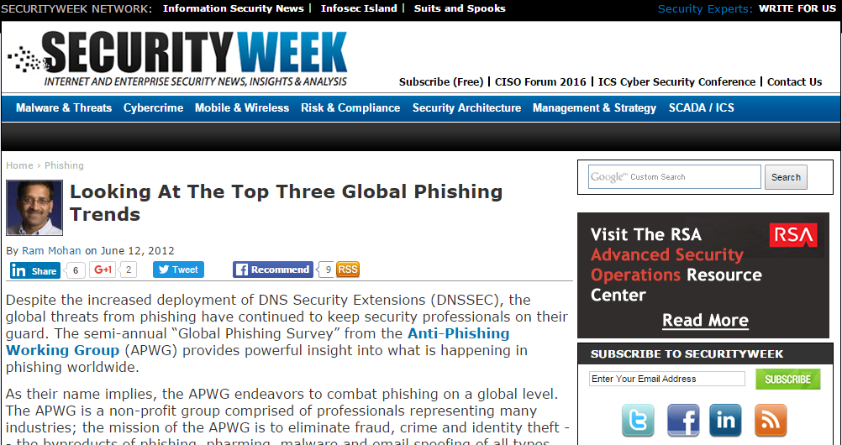
Trend 1: Consolidation of Targets
Trend 2: Explosive Chinese Phishing Growth
Trend 3: Plunging Phishing Uptimes
Notes:
http://www.securityweek.com/looking-top-three-global-phishing-trends

Slide 65
Disney recently requested to be able to fly drones in their own amusement parks. What snag did they hit?

Slide 66
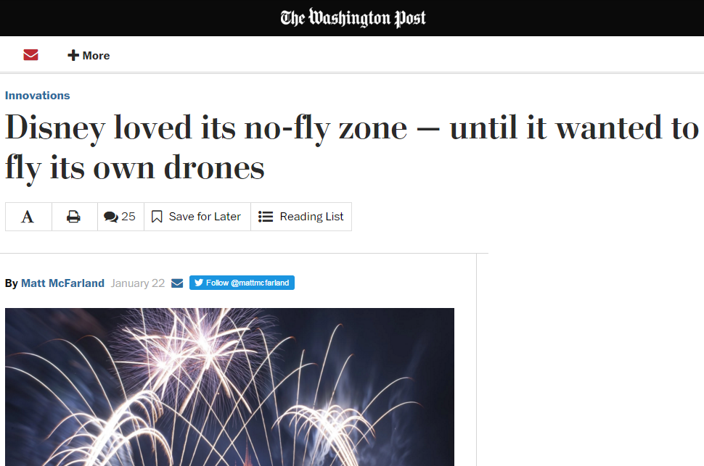
Notes:
https://www.washingtonpost.com/news/innovations/wp/2016/01/22/disney-loved-its-no-fly-zone-until-it-wanted-to-fly-its-own-drones/

Slide 67
What happened when a Chinese TV station replaced its meteorologist with a chatbot?

Slide 68
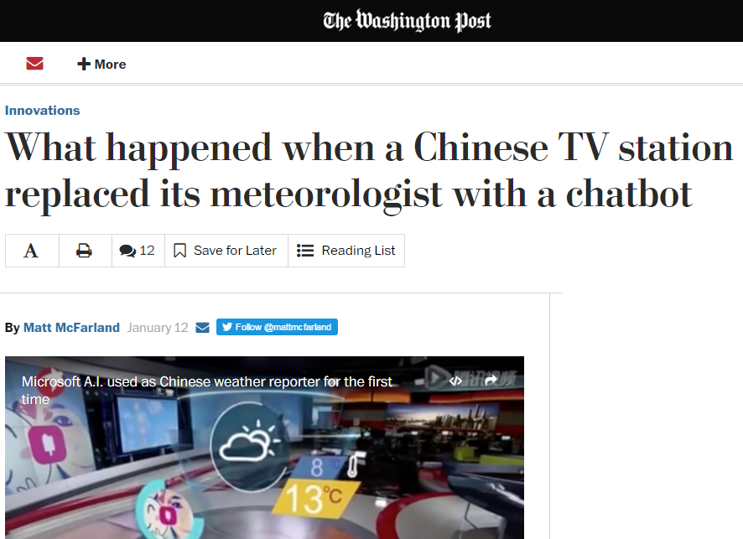
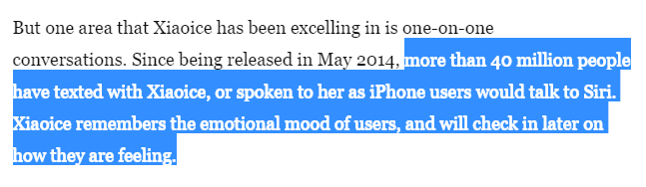
Notes:
https://www.washingtonpost.com/news/innovations/wp/2016/01/12/a-chinese-tv-station-replaced-its-weatherman-with-a-chatbot-and-people-liked-it/

Slide 69
Sadly, a computer just beat a master player at one of the most complex board games. What game?

Slide 70
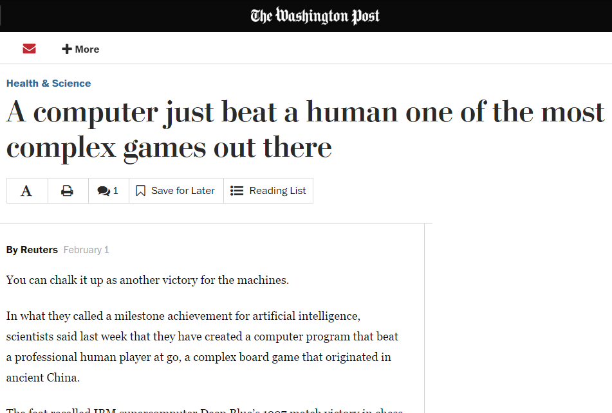
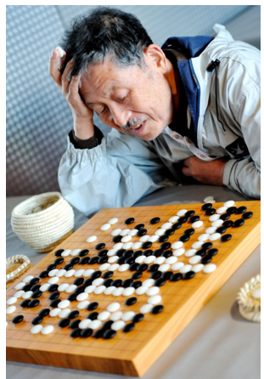

Slide 71
Biggest Stories of the Week

Slide 72
Samsung want customers to stop doing what with their TVs?

Slide 73
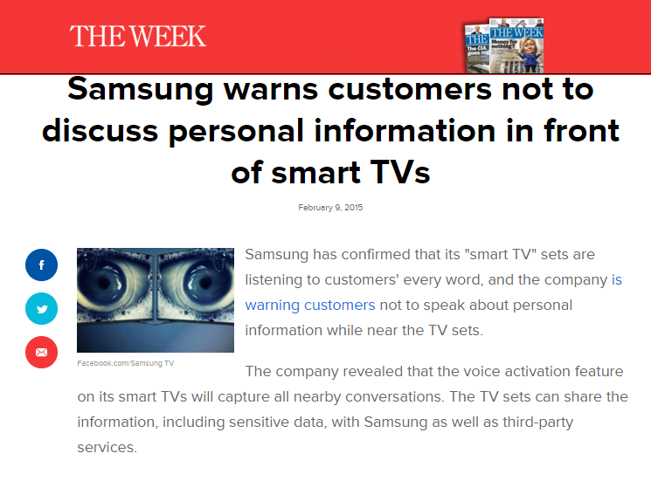
Notes:
http://theweek.com/speedreads/538379/samsung-warns-customers-not-discuss-personal-information-front-smart-tvs

Slide 74
Final question:
Hackers are holding what company’s network hostage for $3.6 million?

Slide 75
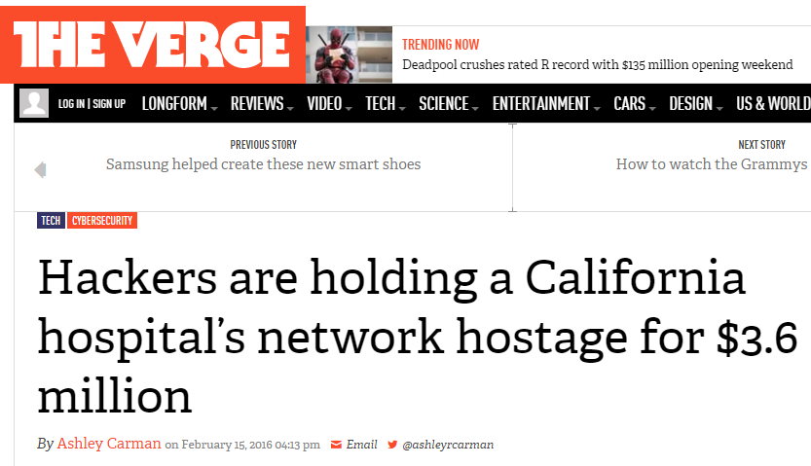
Notes:
http://www.theverge.com/2016/2/15/11004794/california-ransomware-hospital

Slide 76
What is the final score?

Slide 77
To get a copy of the slides
immediately…
mmiller@sonatype.com

Slide 78
Thank You!

